Slide 1
Social Media Profile Viewer
Made by:
Syed Ashar Tahir(24k-0583)
Bilal Ahmed(24k-0777)
Asad ullah bin Tufail(24k-0801)
Ahmed Nadir Shah(24k-0609))

Slide 2
Introduction:
This website works as social media profile viewer where you can add your profile by filling out the required information and then you can post public comments which can be interacted by other people and you can also interact with other profiles and posts.

Slide 3
Main Page

Slide 4
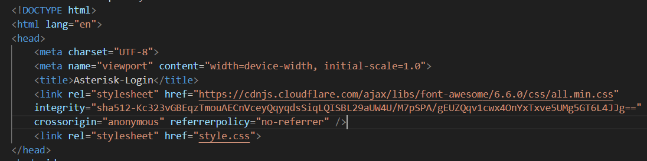
Adding CSS link(style.css):

Slide 5
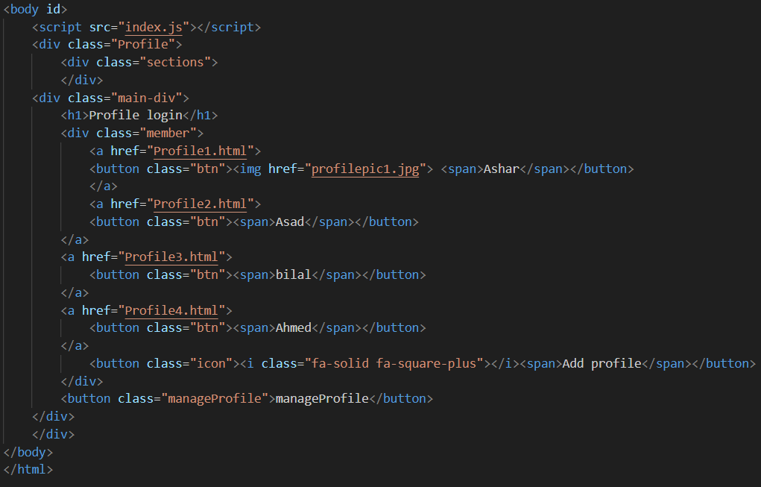
Profile Main page:

Slide 6
Profile Example

Slide 7
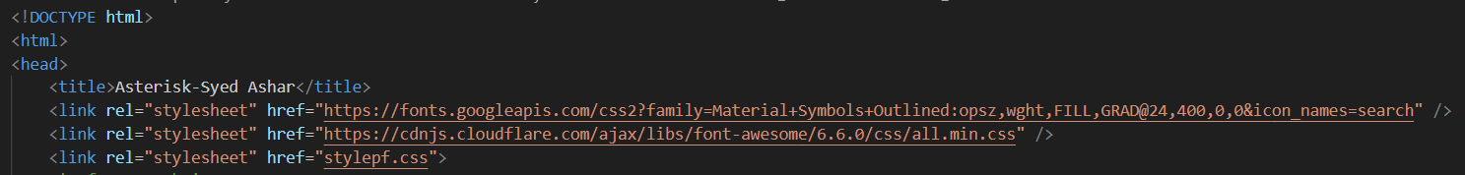
Adding CSS link(stylepf.css):

Slide 8
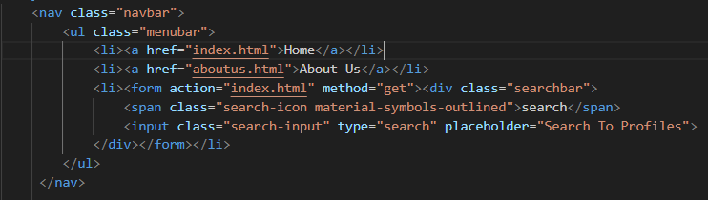
NAV BAR:

Slide 9
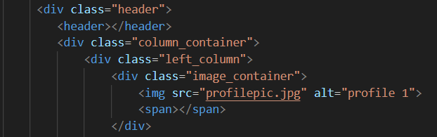
Adding profile Image:

Slide 10
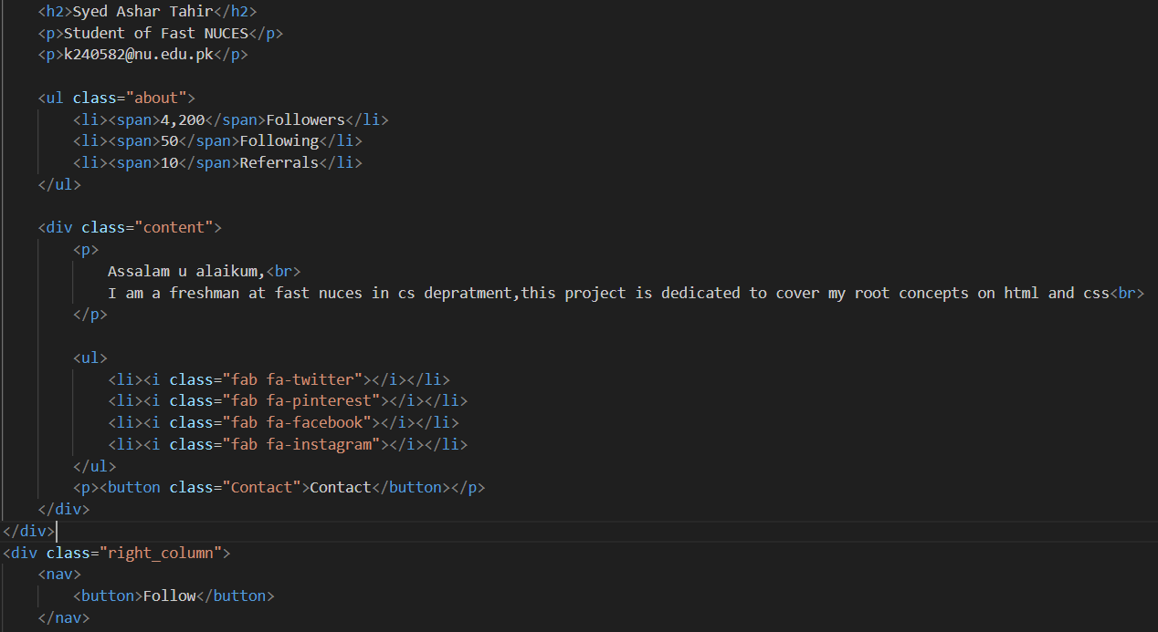
Profile outlook:

Slide 11
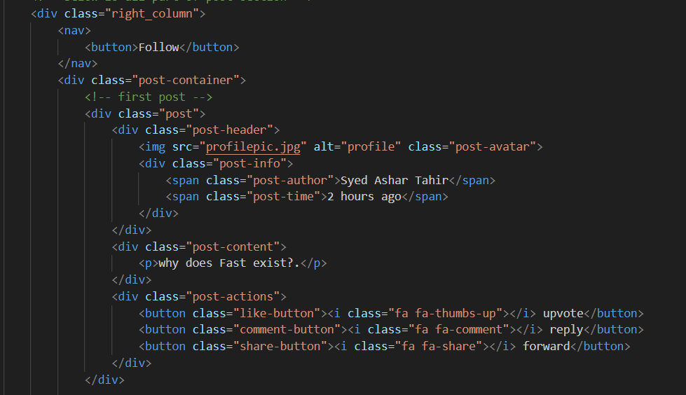
First Post:

Slide 12
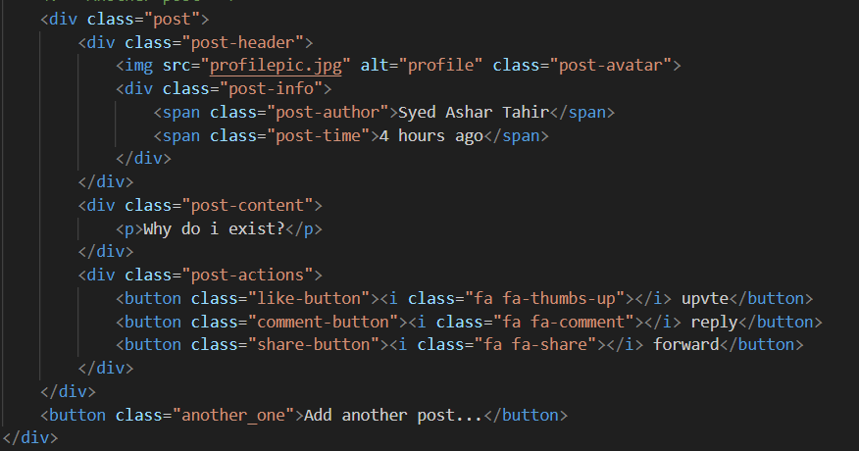
Second Post:

Slide 13
About Us

Slide 14
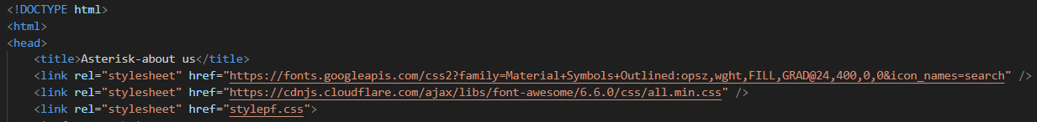
Adding CSS link(stylepf.css):

Slide 15
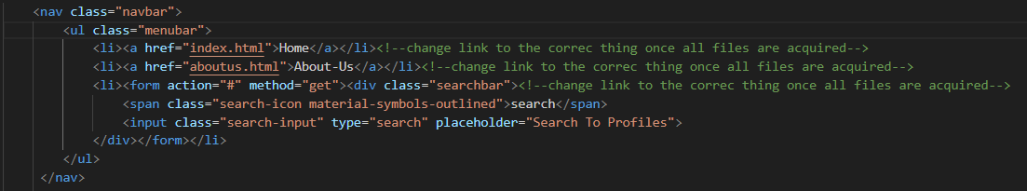
NAV BAR:

Slide 16
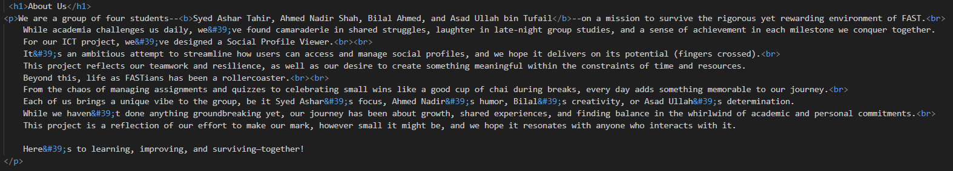
Outlook:

Slide 17
The End

